Slide 1
Information Architecture: Final Project
Group 1
Ramakrishnan Venugopal, Marwan Kanaan, Jatin Kayasth, Pavankumar Pagadala

Slide 2

Agenda
Overview
Data Profile
Conceptual Architecture
Demo
Project Timeline
Team Responsibilities
Challenges & Mitigations

Slide 3


Project Overview
Background: Our work is a part of Department of Transportation Vision Zero Action Plan that was released in 2014 to eliminate Road accident deaths.
Data warehouse Objective: Design, develop and construct an end-to-end data warehouse solution using AWS as the platform to track Death and Serious Injuries on NYC streets linked to car traffic for Insurance companies in the City.
Business case #1: Insurance companies in NYC want to know what are the boroughs where the frequency and intensity of car crashes are the highest in order to adjust car and liability insurances offerings depending on location and customer history of traffic violations.
Business case #2: Help following Vision Zero Task Force groups to build Analytics against our Data Warehouse. We bring also a data set that help understand other traffic violations that might influence car crash frequency.
Reference: https://www.nyc.gov/content/visionzero/pages/vision-zero-scorecard

Slide 4






Project Overview
©◊
©◊
Retrieving the relevant data sources with manual uploads and API configuration.
Building of a data warehouse to extract, transform and store the data to enable querying.
Building Data Visualization to evaluate correlation between traffic violations and accidents.

Slide 5
Data Profile

Slide 6

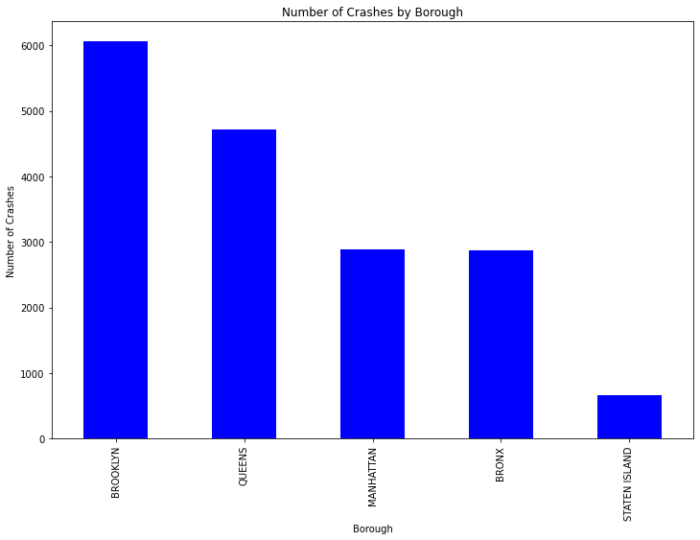
Data Set: Motor Vehicle Collisions
Main Source: Motor Vehicle Collision
Size: 1.97 Million Rows
Grain: Car Crash Event
Features – 29 total : Datetime, Location, Vehicle Type, Crash Cause, Injury Count, Fatality Count, contributing Vehicle, …
Extraction Type : CSV file
Update Frequency: Daily
Data Structure: Structured Data
Data set Link Data Dictionary
Notes:
Introduce Data and then demo in linked Colab

Slide 7
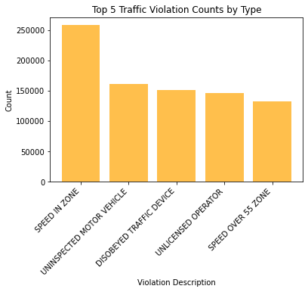
Data Set: Traffic Violations
Second Source: Traffic Violations
Size: 110.8 Million Rows
Grain: Traffic Violation event
Features – 11 total: Violation Description, Year, Month, Court, Age, Gender, State of License, Police Agency, …
Extraction Type : API
Update Frequency: Annually
Data Structure: Structured Data
Data set Link API Documentation
Notes:
Introduce Data and then demo in linked Colab

Slide 8
Conceptual Architecture

Slide 9
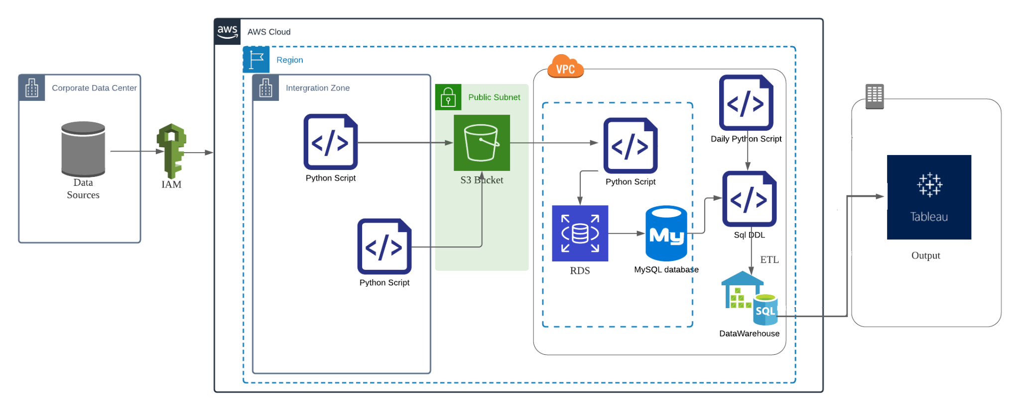
Data Warehouse: Conceptual Architecture

Slide 10
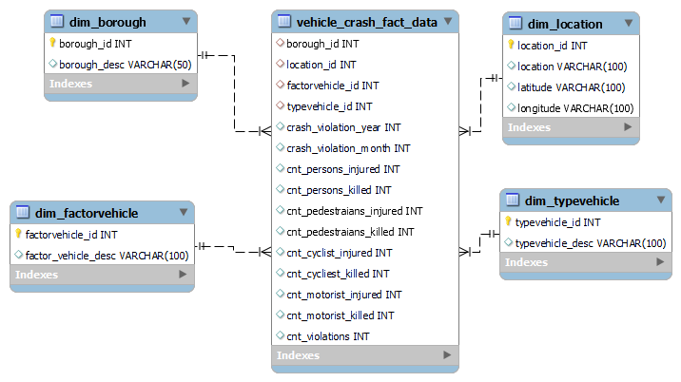
Data Warehouse: Dimensional Model

Slide 11



Assumptions
We only work with data from the year 2022 to facilitate the processing of the workloads. The data sets start from 2012 to 2023.
The common denominator for location in the data sets is the borough. We thus use boroughs as locations of the events of the data warehouse.
If car crashes and traffic violations are frequent in an area, we assume that there is a positive correlation between the two.

Slide 12
Demo

Slide 13
Data Visualizations in Tableau

Slide 14
Project Timeline

Slide 15





Project Milestones & Timeline
Instructions:
Update the timeline slide with the high-level milestones of your project
Highlight the key milestones and specify the key dates for completion.
You do not have to edit the last milestone!
Definition of the scope and the problematic of our final project
Conception and building of the data warehouse using AWS services
Project presentation and peer score evaluation
Selection and analysis of 2 data sets for the project
Connection and configuration of the data visualization tool

Slide 16
Team Responsibilities

Slide 17

Team Responsibilities
Marwan
Jatin
Ramki
Pavan
Roles & Responsibilities
Data Search
Data Analysis
Data Visualization configuration
Data Warehouse Conception
Data Warehouse Execution
Project Lead
Data Warehouse Conception
Data Visualization configuration

Slide 18
Challenges & Mitigations

Slide 19

Challenges & Mitigation
Instructions:
Describe the top 3 challenges of your project and why they were a challenge
1. Data connection failure to upload S3 file to AWS MySQL RDS.
Mitigation : Finally ended up with Python Script to retrieve from S3 & upload to AWS MySQL.
2. Merging Vehicle Crash data (Daily basis) with Traffic violations data (Monthly aggregate).
Mitigation: Leveraged API to pull Traffic violations for the given year,month and Borough.
3. Arriving Scheduler to run daily to download Vehicle crash Data and apply incremental data to the design DW.
Mitigation: Only arrived Conceptual solution, not able to test practically.

Slide 20
Thank you!
Questions?

Slide 21

Assumptions
Instructions:
Describe the assumptions made about your project that contextualize its limitations and constraints.
Feel free to edit/change this slide as much as necessary
1
4
We only work with data from the year 2022.
<<describe assumption>>
2
The common denominator for location in the data sets is the borough. We thus use boroughs as locations
5
<<describe assumption>>
3
If car crashes and traffic violations are frequent in an area, we assume that there is a positive correlation between the two.
6
<<describe assumption>>

Slide 22

Roles and Responsibilities
Project Deliverables | Marwan | Jatin | Pawan | Ramki
DW Requirements Gathering
DW Design
DW Development
Analytics
Testing
Project Management
Final Presentation

Slide 23
Project Requirements
Instructions:
You do not need to edit this slide. This is a summary of the project requirements
1. Design, Document, & Plan
3. Test the Solution
Develop a conceptual design architectures
Develop data flow diagrams and data models
Define analytics concepts with bus matrix
Define ETL Instructions
Define data attributes
A prototype is to be test
Break-testing and optimization of the database may be necessary (use of indexes)
Ensure that error-handling scenarios are considered
2. Develop and Build
4. Present and Deliver
Develop the warehouse solution using Amazon Web Services as the platform
Include two data structures:
Structured dataset
Semi/Unstructured dataset
Integrations:
Batch/Migration
Real-time
Data Visualization
Code Repository (GitHub)
Deliver an executive presentation
Demo the architectural components
Demo the visualizations in a data visualization platform like Tableau

Slide 24
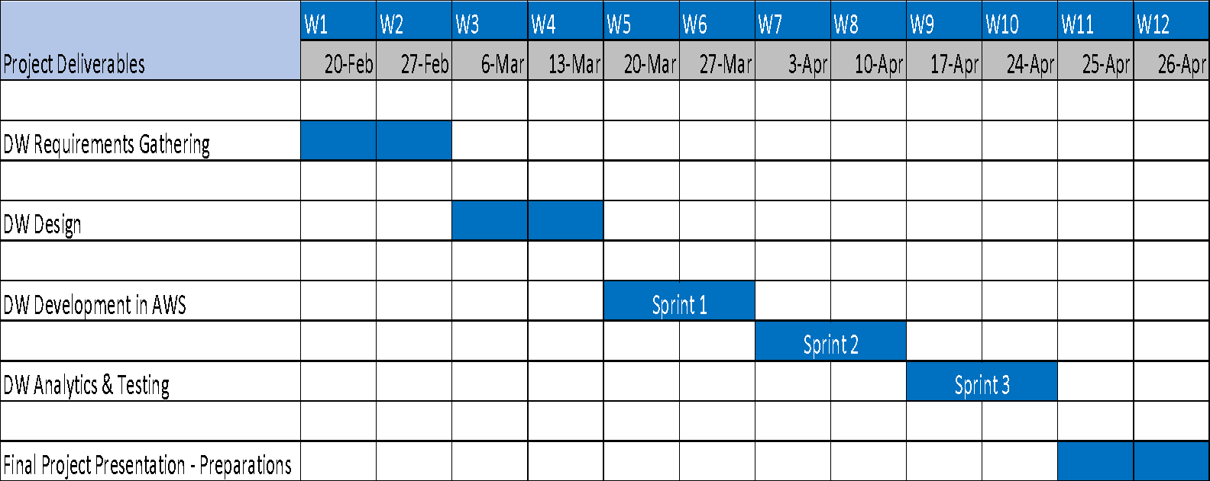
High Project Timelines
Update the Gantt chart

Slide 25
Project Overview
Background: DOT Vision Zero Action Plan was released in 2014 to eliminate Road accident deaths.
Objective of Data warehouse: Design, development and construct an end-to-end data warehouse solution using AWS as the platform:
Track Death and Serious Injuries on NYC streets for Insurance companies in the City
Track current Vision Zero Task Force 63 initiatives and provide additional insights to upcoming 177 new initiatives
Business case #1: Insurance companies in the city of NY want to know what are the neighborhoods in each borough where the frequency and intensity of car crashes are the highest in order to adjust car and liability insurances offerings
Business case #2: Help following Vision Zero Task Force groups to build Analytics against our Data Warehouse. We bring also a data set that help understand other traffic violation that might influence car crash frequency.
Reference: https://www.nyc.gov/content/visionzero/pages/vision-zero-scorecard

Slide 26
Data
Data: https://data.cityofnewyork.us/Public-Safety/Motor-Vehicle-Collisions-Crashes/h9gi-nx95 Data Dictionary : https://data.cityofnewyork.us/api/views/h9gi-nx95/files/bd7ab0b2-d48c-48c4-a0a5-590d31a3e120?download=true&filename=MVCollisionsDataDictionary_20190813_ERD.xlsx
Main Source: NYC Open Data
Size: 1.97 Million Rows
Grain: Crash Event Data
29 Features Including:
Datetime, Location, Vehicle Type, Crash Cause, Injury Count, Fatality Count, Contributing Vehicle
Notes:
Introduce Data and then demo in linked Colab

Slide 27
Vision Zero – Data Warehouse
Background : NYC DOT - Vision Zero Action Plan was released in 2014 to eliminate Road accident deaths
Objective of Data warehouse, Design, development and construct an end-to-end data warehouse solution using AWS as the platform
Track Death and Serious Injuries on NYC streets
Track current Vision Zero Task Force 63 initiatives and provide additional insights to upcoming 177 new initiatives
Help following Vision Zero Task Force groups to build Analytics against our Datawarehouse:
Data Working Group
Marketing Working Group
Fleet Working Group
Bicycle and Micro Mobility Working Group
Reference: https://www.nyc.gov/content/visionzero/pages/vision-zero-scorecard

